Slide 1
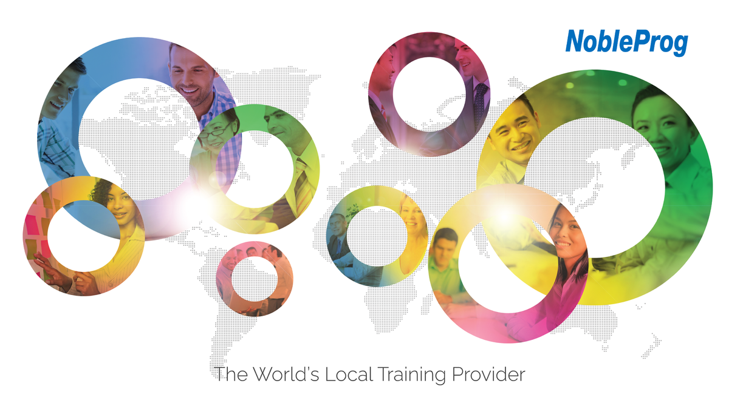
Notes:
1
Good morning. Welcome to your training on Advanced Selenium Automation, delivered by NobleProg
NobleProg has been in training and consultancy for more than 12 years, with offices across 13 countries and over 500 trainers in different fields of expertise. We have served more than 5000 companies with over 46,000 satisfied delegates

Slide 2
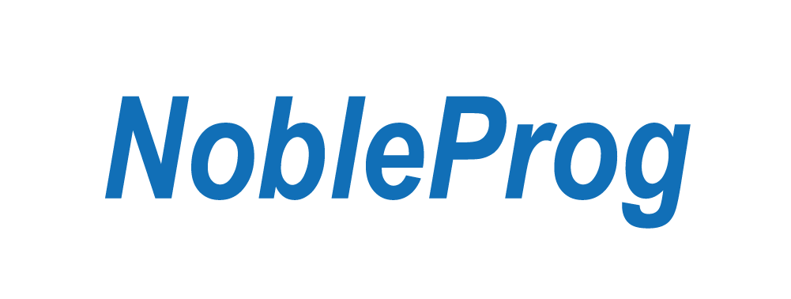
Docker and Kubernetes
Trainer – Kumbulani Conrad Tshuma
Notes:
2

Slide 3
Agenda
Docker and Linux container technology
Kubernetes reference architecture and its main components
Advanced controllers: Daemon Sets and Stateful Sets

Slide 4
Day 1

Slide 5
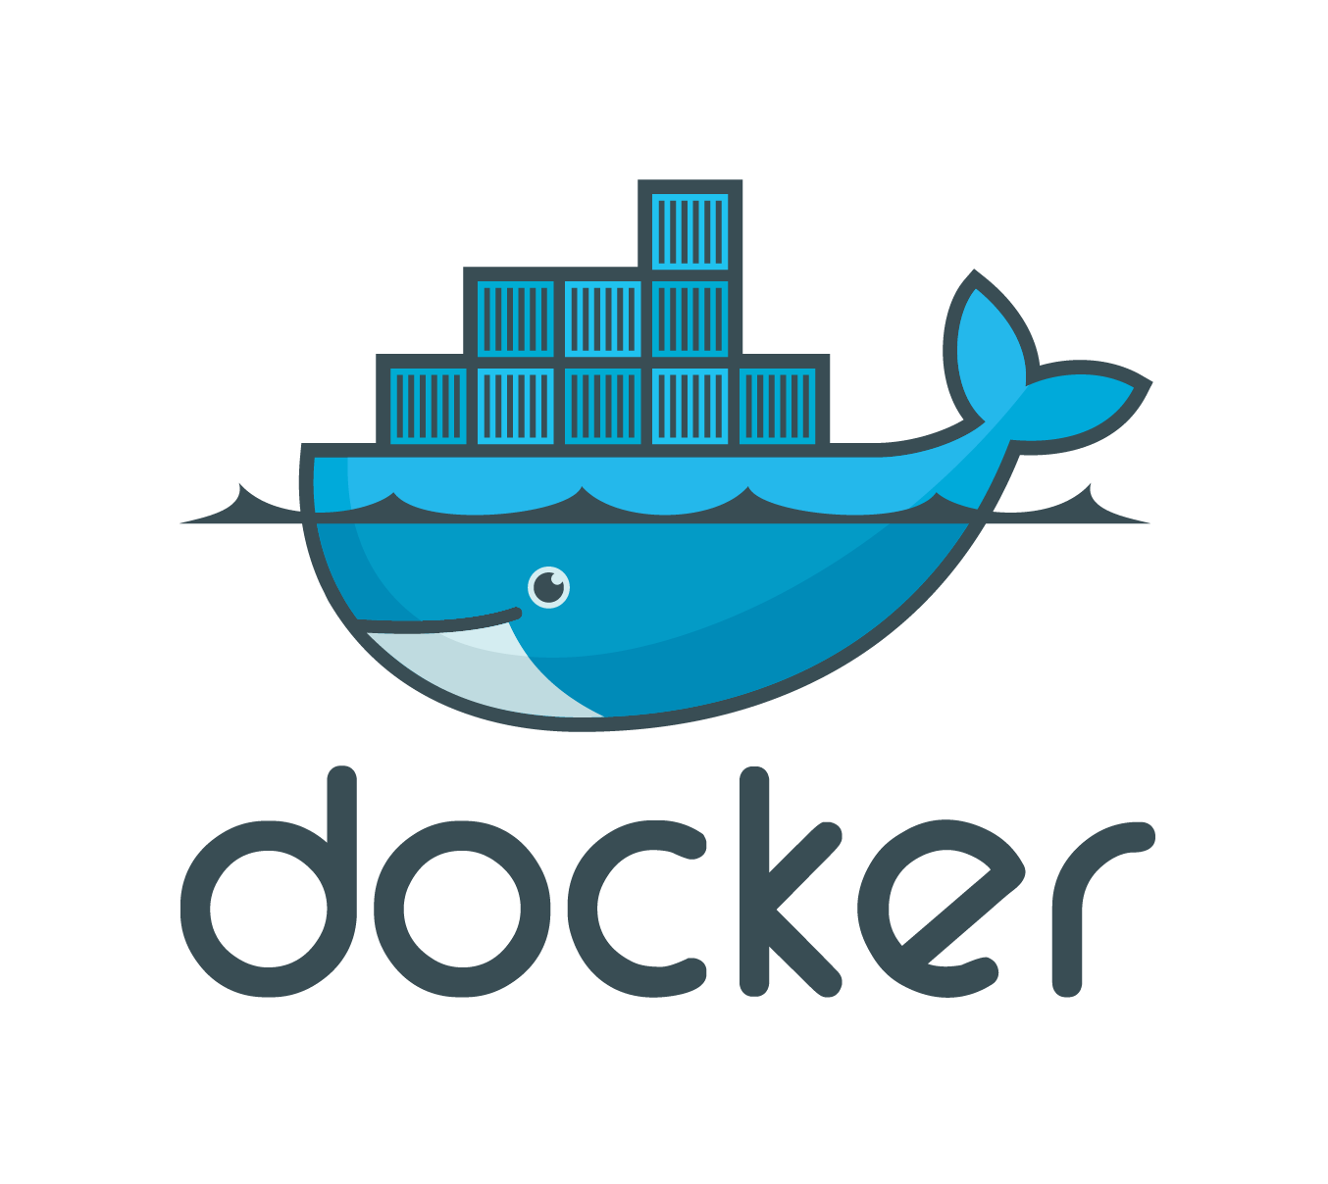
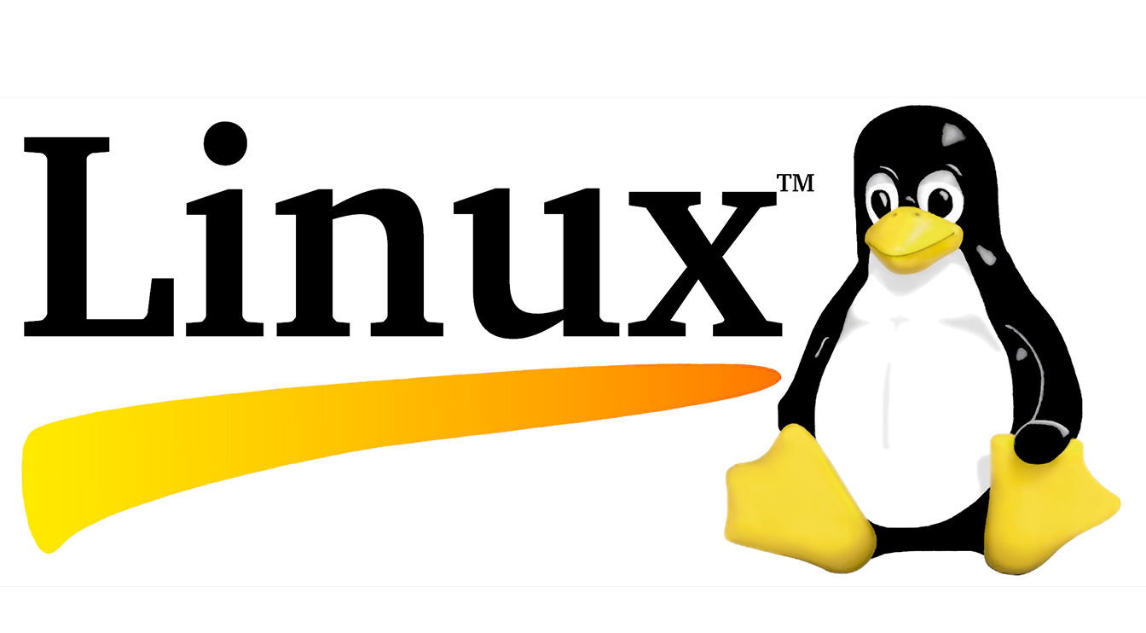
Docker and Linux Technology?
Docker is an open-source platform that allows you to automate the deployment, scaling, and management of applications using containerization. It provides a lightweight, isolated environment called a container, which packages an application and its dependencies together, ensuring that it runs consistently across different environments.
Linux, on the other hand, is an open-source operating system kernel that serves as the foundation for many different Linux distributions, such as Ubuntu, Fedora, and CentOS. Linux provides a powerful and flexible environment for running applications and managing resources. It is widely used in server environments and has become the dominant operating system for running Docker containers.

Slide 6
Docker leverages Linux containerization technologies, such as cgroups (control groups) and namespaces, which are built into the Linux kernel. These technologies provide the necessary isolation and resource management capabilities to run multiple containers on a single host.
By using Docker on Linux, you can easily create, deploy, and manage applications in a consistent and reproducible manner. Docker allows you to define application dependencies, network settings, and other configurations in a Dockerfile, which can be used to build Docker images. These images can then be run as containers on any Linux host that has Docker installed, without worrying about differences in underlying operating systems or dependencies.
Docker has gained popularity because it simplifies the deployment and management of applications, improves scalability, and enables efficient resource utilization. It also promotes the use of microservices architecture, where applications are broken down into smaller, loosely coupled components that can be developed, tested, and deployed independently.
Overall, Docker and Linux technologies complement each other, with Docker relying on Linux containerization features to provide a portable and efficient platform for application deployment and management.

Slide 7
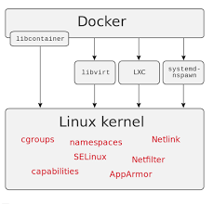
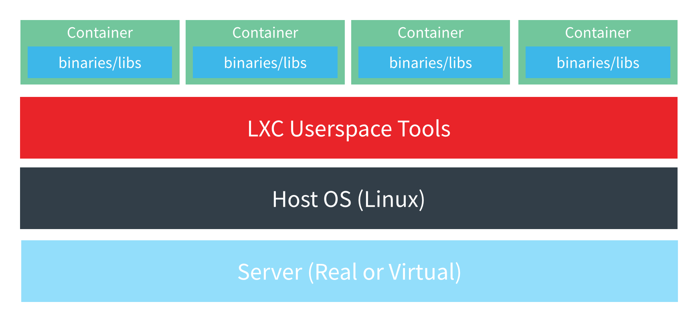
Docker Architecture

Slide 8
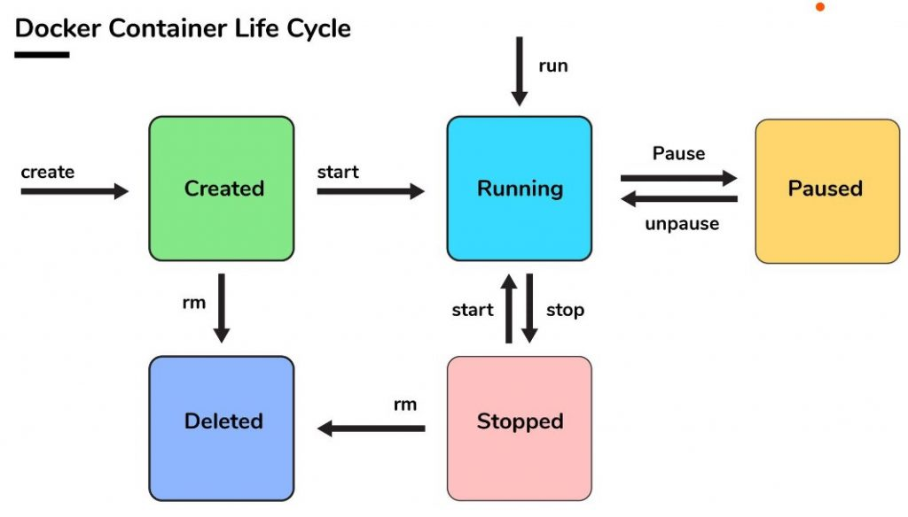
Docker Container lifecycle
Creating a container: You start by creating a Docker container from an existing Docker image. An image is a read-only template that includes the application code, runtime, dependencies, and other required files. Using the docker run command, you can create a container based on an image, specifying various options such as port mappings, volume mounts, and environment variables.
Running a container: Once a container is created, you can start it using the docker start command. The container will then run as a separate and isolated process on the host system, utilizing the allocated CPU, memory, and other resources.
Interacting with a container: You can interact with a running container in various ways. The docker exec command allows you to execute commands inside a running container, providing a shell-like interface. You can also attach to a running container's console using the docker attach command to view its output or interact with the application running inside.
Monitoring container: Docker provides several commands and options to monitor the health and performance of containers. The docker stats command shows real-time resource usage statistics for running containers, such as CPU and memory usage. You can also configure container-level logging and monitoring using third-party tools or Docker's built-in features.
Stopping a container: To stop a running container, you can use the docker stop command, which sends a signal to the container's main process, allowing it to gracefully shut down. Alternatively, you can use the docker kill command to force-stop a container by sending a SIGKILL signal, terminating it immediately.
Restarting a container: Docker provides options to automatically restart containers when they exit or when the Docker daemon restarts. By specifying the --restart flag with the docker run or docker update commands, you can define the restart policy for the container.
Removing a container: When you no longer need a container, you can remove it using the docker rm command. This will delete the container and its associated resources, such as network settings and storage volumes. By default, you cannot remove a running container, so you need to stop it first or use the --force flag.

Slide 9
Pulling an image: To download an image from a registry, you can use the docker pull command followed by the image name and optionally the tag. For example, docker pull ubuntu will download the latest Ubuntu image.
Listing images: You can view the list of images on your local system using the docker images command. It will display the image ID, repository, tag, and size.
Building an image: Docker allows you to build custom images using a Dockerfile, which contains instructions for building the image. The docker build command is used for this purpose. You provide the path to the directory containing the Dockerfile and Docker will execute the instructions to create the image.
Tagging an image: You can tag an existing image with a custom tag using the docker tag command. This is useful when you want to give the image a more meaningful name or version. The command format is docker tag SOURCE_IMAGE[:TAG] TARGET_IMAGE[:TAG].
Pushing an image: If you have made changes to an image or created a new one, you can push it to a registry using the docker push command. This requires authentication with the registry. The command format is docker push [OPTIONS] NAME[:TAG].
Inspecting an image: To get detailed information about an image, such as its metadata, layers, and exposed ports, you can use the docker image inspect command followed by the image name or ID.
Removing an image: When you no longer need an image, you can remove it using the docker rmi command followed by the image name or ID. By default, Docker does not allow you to remove an image if it is being used by a running container. You can use the --force flag to forcibly remove the image.
Searching for images: Docker Hub is a popular public registry for Docker images. You can search for images on Docker Hub using the docker search command followed by a keyword. For example, docker search nginx will list available NGINX images.

Slide 10
Continue..
Default bridge network: When you create a Docker container without explicitly specifying a network, it is connected to the default bridge network. Containers on the same bridge network can communicate with each other using IP addresses. Docker assigns IP addresses from the same subnet to containers connected to the default bridge network, allowing them to communicate directly using those IP addresses.

Slide 11
Continue..
Explicitly creating a network: Docker allows you to create custom networks using the docker network create command. Containers connected to the same custom network can communicate with each other using their container names or container IP addresses. This enables you to group related containers together and isolate them from containers in other networks.

Slide 12
Continue..
Linking containers: Container linking is a legacy feature in Docker that allows one container to access another container's exposed ports and environment variables. By using the --link option during container creation, you can establish a secure tunnel between containers. This method is discouraged in favor of using user-defined networks for better flexibility and control.

Slide 13
Continue..
Container DNS: Docker provides a built-in DNS resolution mechanism that enables containers to communicate using container names as hostnames. Each container has its own DNS resolver, and by default, Docker configures it to resolve container names to their IP addresses. This allows containers to communicate with each other using the container name as the hostname.

Slide 14
Continue..
Service discovery: Docker also supports service discovery mechanisms that enable containers to discover and communicate with each other dynamically. Docker Swarm, for example, provides a built-in DNS-based service discovery system, where containers can refer to services by their service names, and Docker automatically routes the requests to the appropriate containers.

Slide 15
Continue..
Container ports: Containers can expose specific ports, and other containers or external systems can communicate with them through those ports. By using the -p or --publish option during container creation, you can map container ports to host ports, allowing external systems to access the container services

Slide 16
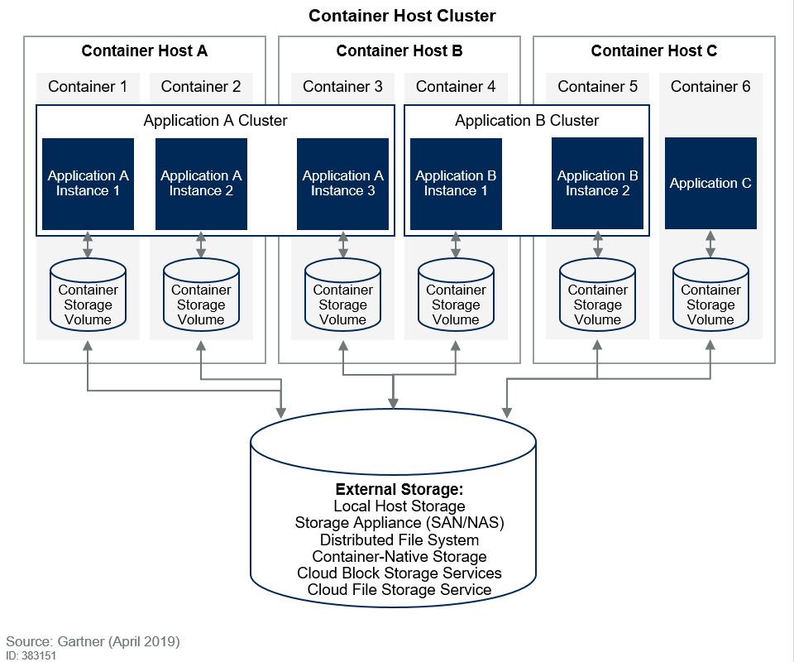
Persistance of data in containers
Data persistence in containers is an important consideration when working with Docker. Containers, by default, are designed to be ephemeral, meaning that any data written inside a container is temporary and will be lost when the container is removed or stopped. However, Docker provides several mechanisms to handle data persistence. Here are some common approaches:

Slide 17
Continue..
Volumes: Volumes are the recommended way to handle data persistence in Docker containers. A volume is a separately managed directory on the host or within Docker's storage system that can be mounted into one or more containers. Volumes allow data to be stored outside the container's lifecycle, ensuring that it persists even if the container is removed. You can create and manage volumes using the docker volume command or by specifying volume mounts in the docker run command.

Slide 18
Continue..
Bind mounts: Bind mounts provide a way to directly mount a directory from the host machine into a container. With bind mounts, the data is stored on the host file system, and any changes made inside the container are reflected on the host and vice versa. This allows you to leverage the host's file system for data persistence. Bind mounts are created by specifying the source and target directories in the docker run command using the -v or --volume flag.

Slide 19
Continue..
Named volumes: Named volumes are a specific type of volume that is given a user-friendly name and managed by Docker. Named volumes abstract the underlying storage location, making it easier to manage and share data across containers. You can create and use named volumes using the docker volume command or by specifying the volume name in the docker run command.

Slide 20
Continue..
Temporary storage: Containers also have a temporary storage area called the container's filesystem. Data written to this filesystem will be lost when the container is removed. However, you can still use this temporary storage for temporary files or caches that do not need to persist.

Slide 21
EXERCISE……

Slide 22
pull a docker container- docker pull
Run a docker container- docker run <container name/ID>
Check the images on the host – docker images
Checking what containers are running – docker ps -a
Port forward – docker run –p hostport:containerport <container ID/Name>
Create a network - docker create network
Connect to a container – docker exec –it <container ID/Name> /bin/bash
Tag an image – docker run –t <name> .
Search for an image- docker search <image>
Remove images- docker rmi <container ID/Name>
EXERCISE
1)Pull a nginx image , and have it running , map it so you can see its contents on host web page
2)Create a Dockerfile that will pull an nginx image, and then copies the file index.html(should contain the below contents) to /usr/share/nginx/html and have it start the webserver, and show the contents of the file

Slide 23
Index.html
# curl http://localhost
<!DOCTYPE html>
<html>
<head>
<title>Welcome to nginx!</title>
<style> body { width: 35em; margin: 0 auto; font-family: Tahoma, Verdana, Arial, sans-serif; }
</style>
</head>
<body>
<h1>Welcome to nginx!</h1>
<p>If you see this page, the nginx web server is successfully installed and working. Further configuration is required.</p>
<p>For online documentation and support please refer to <a href="http://nginx.org/">nginx.org</a>.<br/> Commercial support is available at <a href="https://www.nginx.com/">nginx.com</a>.</p>
<p><em>Thank you for using nginx.</em></p>
</body>
</html>

Slide 24
ANSWERS
Docker pull nginx
Docker run –d nginx
Docker run –d –p 8080:80 nginx
Dockerfile
FROM nginx:latest
COPY ./index.html /usr/share/nginx/html/index.html

Slide 25
Install Docker on windows or Linux
git clone https://github.com/docker/getting-started.git
cd \path\to\app
type nul > Dockerfile
Add the below into Dockerfile
# syntax=docker/dockerfile:1
FROM node:18-alpine
WORKDIR /app
COPY /src/ /app/
RUN yarn install --production
CMD ["node", "src/index.js"]
EXPOSE 3000

Slide 26
Build the container image using the following commands:
In the terminal, change directory to the getting-started/app directory. Replace /path/to/app with the path to your getting-started/app directory.
cd /path/to/app
docker build -t getting-started .
Start your container using the docker run command and specify the name of the image you just created:
$
docker run -dp 3000:3000 getting-started

Slide 27
For all exercises please go to the below github repo
https://github.com/kumbulanit/docker-and-kubernetes-trainning.git

Slide 28
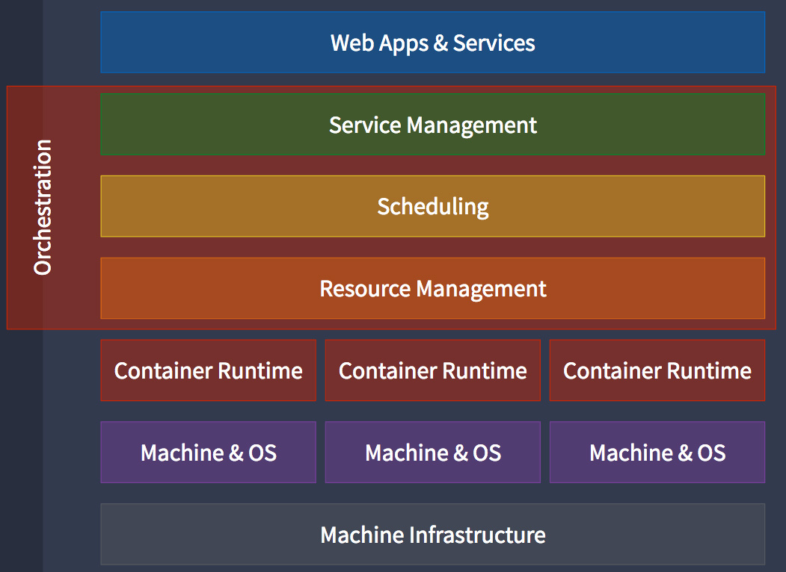
Container orchestration
Container orchestration is the process of managing, deploying, and scaling containers in a clustered environment. It helps automate various tasks related to container management, such as provisioning, scaling, networking, and load balancing. When considering container orchestration, several requirements should be taken into account

Slide 29
Requirements
High availability: The container orchestration platform should ensure that containers and applications are highly available, with mechanisms for rescheduling containers in the event of failures and automatic scaling to handle increased load.
Scalability: The ability to scale containers horizontally, adding or removing instances of containers based on resource utilization or demand, is a critical requirement. The orchestration platform should provide scaling mechanisms to handle dynamic workloads.
Service discovery and load balancing: Containers should be able to discover and communicate with each other efficiently. The orchestration platform should provide service discovery mechanisms to enable containers to find each other dynamically. Load balancing capabilities are also essential to distribute traffic across container instances.
Networking and connectivity: Containers in a cluster should have network connectivity and be able to communicate securely. The orchestration platform should handle networking aspects, including container IP addressing, container-to-container communication, and connectivity with external networks.

Slide 30
Continue
Health monitoring and self-healing: Continuous monitoring of container health and automatic recovery in case of failures are crucial requirements. The orchestration platform should provide health checks, monitoring capabilities, and mechanisms to automatically restart or replace unhealthy containers.
Rolling updates and rollback: The ability to perform rolling updates, where new container versions are gradually deployed while maintaining service availability, is important. Additionally, the orchestration platform should support rollback mechanisms to revert to a previous version if issues arise during an update.
Security and access control: Container orchestration platforms should provide robust security features, including secure container runtime environments, isolation between containers, and access control mechanisms for managing user and application permissions.

Slide 31
Container Orchestration tools
There are several container orchestration options available, including:
Kubernetes: Kubernetes is the most popular container orchestration platform, offering comprehensive features and a large ecosystem. It provides all the required functionalities for managing containerized applications at scale.
Docker Swarm: Docker Swarm is Docker's native orchestration solution, which offers a simpler and lightweight alternative to Kubernetes. It integrates well with the Docker ecosystem and is suitable for smaller deployments.
Apache Mesos: Apache Mesos is a distributed systems kernel that can handle various workloads, including containers. It provides advanced features for managing and scheduling containers alongside other applications.
HashiCorp Nomad: Nomad is a lightweight and flexible orchestration platform that supports container and non-container workloads. It focuses on simplicity and ease of use, while still offering robust features.

Slide 32
Introduction to Kubernetes
Kubernetes is an open-source container orchestration platform initially developed by Google. It provides a robust and scalable environment for automating the deployment, scaling, and management of containerized applications. Kubernetes, often abbreviated as K8s (as there are eight letters between "K" and "s" in "Kubernetes"), has gained significant popularity and has become the de facto standard for container orchestration.

Slide 33
Kubernetes Key Features
Container management: Kubernetes manages the lifecycle of containers, allowing you to easily deploy, scale, update, and remove containers. It abstracts the underlying infrastructure and provides a consistent and standardized way of interacting with containers.
Orchestration: Kubernetes automates the scheduling and placement of containers across a cluster of machines. It ensures that the desired number of container instances are running, distributes workloads evenly, and handles container health monitoring, self-healing, and rescheduling.
Scaling and load balancing: Kubernetes provides horizontal scaling capabilities, allowing you to scale up or down the number of container instances based on resource utilization or application demand. It also includes built-in load balancing mechanisms to distribute network traffic across container instances.
Service discovery: Kubernetes provides service discovery capabilities, allowing containers to easily discover and communicate with each other within a cluster. It assigns a unique DNS name to each service, and containers can discover other services using DNS or environment variables.
Rolling updates and rollback: Kubernetes supports rolling updates, enabling you to perform updates to applications without causing downtime. It gradually replaces old container instances with new ones, ensuring high availability. In case of issues during an update, Kubernetes supports rollback mechanisms to revert to a previous stable version.
Storage orchestration: Kubernetes integrates with different storage systems and provides mechanisms for managing persistent storage volumes. It supports dynamic provisioning of storage, allowing applications to request and use storage resources dynamically.
Secrets and configuration management: Kubernetes provides built-in mechanisms for managing sensitive information, such as passwords, API keys, and SSL certificates, as secrets. It also supports configuration management through ConfigMaps, allowing you to manage application configurations separately from the container images

Slide 34
Kubernetes Core Concepts
Pods: A pod is the smallest and most basic unit in Kubernetes. It represents a single instance of a running process in the cluster. A pod can contain one or more tightly coupled containers that share the same network namespace, IP address, and storage volumes. Pods are used to deploy and manage containerized applications.
Labels: Labels are key-value pairs attached to Kubernetes objects like pods, services, and deployments. Labels are used to identify and organize resources. They can be used for grouping, selecting, and filtering objects when working with Kubernetes operations like scaling, updating, or deleting resources.

Slide 35
Continue….
Controllers: Controllers are responsible for managing the desired state of Kubernetes objects. They ensure that the actual state matches the desired state by creating, updating, and deleting resources as needed. Some commonly used controllers are:
ReplicationController: Ensures that a specified number of pod replicas are running at all times.
Deployment: Provides declarative updates for pods and manages their rollout and rollback.
StatefulSet: Manages the deployment of stateful applications, ensuring stable network identities and ordered deployment.
DaemonSet: Ensures that a copy of a pod runs on every node in the cluster.
Job: Runs a task or set of tasks to completion, such as batch processing or data migration.

Slide 36
Continue…
Services: Services enable networking and communication between pods and external entities. They define a stable virtual IP address and DNS name that can load balance traffic to a set of pods based on labels. Services can be exposed internally within the cluster or externally to the outside world.
Secrets: Secrets are used to store sensitive information, such as passwords, API keys, or certificates, securely within the cluster. Secrets are base64-encoded data and can be accessed by pods as environment variables or mounted as files.
Persistent Volumes (PV) and Persistent Volume Claims (PVC): Persistent Volumes provide a way to store data outside of pods and retain it even if the pods are terminated. Persistent Volume Claims are requests for a Persistent Volume with specific characteristics (e.g., size, access mode). PVCs are used by pods to request and use the storage provided by PVs.

Slide 37
Continue….
Namespaces: Namespaces provide a way to logically divide a cluster into multiple virtual clusters. They are used to separate resources and provide isolation and resource allocation within a cluster. Namespaces help manage and organize resources, prevent naming conflicts, and control access and resource usage.
Resource Quotas: Resource Quotas allow you to limit and allocate resources (CPU, memory, storage) within a namespace. They ensure that one namespace doesn't consume excessive resources and affect the overall cluster performance

Slide 38
Continue…
Pods: Pods are the fundamental building blocks of Kubernetes and represent a single instance of a running process or workload. A pod can contain one or more containers that share the same network namespace, IP address, and storage volumes. Pods are scheduled onto worker nodes, and the containers within a pod are co-located and co-scheduled.
Services: Services provide a stable network endpoint to access a group of pods. They abstract the underlying pod instances and provide load balancing and service discovery mechanisms. Services can be exposed internally within the cluster or externally to the outside world, allowing connectivity to the pods and their applications.
Ingress: Ingress is an optional component that serves as an entry point for external traffic into the cluster. It provides routing rules and load balancing for incoming requests to different services based on hostnames, paths, or other criteria. Ingress controllers, such as Nginx Ingress or Traefik, are responsible for implementing and managing the ingress rules.
Volumes: Volumes provide a way to store and persist data in Kubernetes. They are attached to pods and provide storage that survives container restarts and rescheduling. Kubernetes supports various volume types, such as hostPath, emptyDir, persistentVolumeClaim (PVC), and cloud provider-specific volumes.

Slide 39
Continue…
Controllers: Controllers manage the desired state of different Kubernetes objects and ensure that the actual state matches the desired state. Controllers include Deployment, StatefulSet, ReplicaSet, and DaemonSet, among others. They handle tasks such as scaling, rolling updates, and self-healing of the pods and applications
ConfigMaps: ConfigMaps store configuration data that can be consumed by pods as environment variables or mounted as files. They allow decoupling of configuration from the container image, making it easier to manage and update configurations independently.
Secrets: Secrets store sensitive information, such as passwords, API keys, or certificates, securely within the cluster. They are similar to ConfigMaps but are encoded and encrypted to protect sensitive data.
Monitoring and logging: Monitoring and logging tools are crucial components of a Kubernetes reference architecture. Popular solutions like Prometheus, Grafana, and ELK (Elasticsearch, Logstash, and Kibana) are commonly used to collect and analyze metrics, logs, and events from the cluster and its applications.

Slide 40
Continue…
Authentication and authorization: Kubernetes provides mechanisms for authentication and authorization to secure cluster access. This includes integration with identity providers (such as LDAP or OIDC), role-based access control (RBAC), and other authentication methods like client certificates or service accounts.

Slide 41
Day 2

Slide 42
Containers network model in Kubernetes
In Kubernetes, the container network model provides networking capabilities and allows communication between pods and services within a cluster. It abstracts the underlying network infrastructure and provides a unified networking model for containerized applications. The key components of the container network model in Kubernetes are as follows
Pod Network: A pod network is a virtual network overlay that connects pods within a Kubernetes cluster. It allows pods to communicate with each other directly using IP addresses. Each pod gets its own IP address, and containers within the pod share the same network namespace, enabling them to communicate over the loopback interface.
Container Network Interface (CNI): CNI is a specification that defines how networking is implemented for containers in a cluster. It allows different networking plugins to be used in a Kubernetes cluster. Networking plugins, also known as CNI plugins, provide the implementation of the network model by creating virtual network interfaces, managing IP addresses, and setting up network routing rules for pods.
The type of cluster networking used in the context of containers and Kubernetes must address four distinct types of communications: pod-to-pod, pod-to-service, external-to-service and tightly coupled container-to-container.(e.g Calico, weave,contiv,multus)

Slide 43
Containers network model in Kubernetes
Network Overlay: Kubernetes uses a network overlay to create a virtual network that spans across all the nodes in the cluster. It allows pods running on different nodes to communicate with each other seamlessly, even though they may be running on different physical or virtual machines. Network overlays use encapsulation techniques, such as VXLAN, Geneve, or IP-in-IP, to encapsulate and transport the network packets between pods across the cluster.
Service Discovery: Services in Kubernetes provide a stable endpoint for accessing a group of pods. When a service is created, it gets an IP address and DNS name. Service discovery mechanisms, such as DNS or environment variables, allow other pods or external entities to discover and communicate with the service using the service's IP or DNS name
Service Load Balancing: Kubernetes provides built-in load balancing for services. Incoming traffic to a service is load balanced across the pods that are part of the service. This load balancing ensures that requests are distributed evenly across the available pods, improving availability and scalability of the application.
Ingress: Ingress in Kubernetes provides a way to expose HTTP and HTTPS services to the outside world. Ingress controllers, such as Nginx Ingress or Traefik, handle the incoming traffic and route it to the appropriate services within the cluster based on rules defined in the Ingress resource.

Slide 44
Containers network model in Kubernetes
Network Policies: Network policies in Kubernetes allow fine-grained control over network traffic between pods. They provide a declarative way to specify ingress and egress rules, defining what traffic is allowed or denied based on source IP, destination IP, ports, and other parameters. Network policies help enforce security and isolation within the cluster.

Slide 45
Service Discovery,scaling, load balancing
Service Discovery: Service discovery is the process of dynamically locating and accessing services within a cluster or network. In Kubernetes, services act as an abstraction layer that provides a stable and virtual IP address for a group of pods. Service discovery mechanisms in Kubernetes include:
DNS-based Service Discovery: Kubernetes assigns a DNS name to each service in the cluster. Other pods or external entities can use this DNS name to resolve the IP address of the service and establish communication.
Environment Variables: Kubernetes automatically sets environment variables for each service within a pod. These variables contain the IP address and port of the service, allowing applications to directly communicate with the service using the environment variables.
Service discovery enables easy communication and decouples the service consumers from the specific IP addresses or pod instances. It simplifies the management of dynamic environments where pods may be created, terminated, or scaled up/down dynamically.

Slide 46
Service Discovery,scaling, load balancing
Scaling: Scaling refers to the ability to adjust the number of running instances (replicas) of a service based on application demand. Kubernetes provides multiple scaling mechanisms:
Horizontal Pod Autoscaler (HPA): HPA automatically scales the number of pod replicas based on CPU utilization or custom metrics defined by the user. It uses the metrics to calculate the desired number of replicas and scales them up or down accordingly.
Vertical Pod Autoscaler (VPA): VPA adjusts the resource allocations (CPU and memory) of individual pods based on their resource usage patterns. It ensures that each pod gets the required resources for optimal performance.
Cluster Autoscaler: Cluster Autoscaler adjusts the size of the Kubernetes cluster by adding or removing nodes based on the resource demands of the applications running in the cluster. It helps ensure that sufficient resources are available to handle workload spikes and optimize resource utilization.
Scaling in Kubernetes allows applications to handle increased traffic or workload by dynamically provisioning additional replicas or resources. It ensures high availability, improved performance, and efficient resource utilization.

Slide 47
Service Discovery,scaling, load balancing
Load Balancing: Load balancing distributes network traffic across multiple instances of a service to ensure optimal utilization and availability. Kubernetes offers built-in load balancing mechanisms:
Service Load Balancer: Kubernetes assigns a virtual IP address to each service, and incoming traffic is load balanced across the available pod replicas associated with that service. The load balancing algorithm ensures that requests are distributed evenly, preventing any single replica from being overwhelmed.
Ingress Controller: Ingress provides external access to services within the cluster and includes load balancing capabilities. Ingress controllers, such as Nginx Ingress or Traefik, handle incoming traffic and distribute it to the appropriate services based on routing rules defined in the Ingress resource.
Load balancing in Kubernetes improves application scalability, availability, and fault tolerance. It ensures that traffic is evenly distributed, eliminates single points of failure, and improves overall performance.

Slide 48
DNS for Delivery Service
In Kubernetes, DNS (Domain Name System) is a widely used and recommended mechanism for service discovery. Kubernetes assigns a DNS name to each service within the cluster, making it easier for other pods or external entities to locate and communicate with the services.

Slide 49
Continue..
Here's how DNS-based service discovery works in Kubernetes:
Service DNS Names: When a service is created in Kubernetes, it is assigned a DNS name. The DNS name is in the format <service-name>.<namespace>.svc.cluster.local. For example, if you have a service named "my-service" in the "default" namespace, its DNS name would be "my-service.default.svc.cluster.local".
Pod DNS Resolution: Every pod in the cluster is configured with a DNS resolver that knows how to resolve these service DNS names. When a pod needs to communicate with a service, it can simply use the DNS name, and the DNS resolver in the pod will resolve it to the appropriate IP address.
DNS Caching: Kubernetes deploys a DNS server, often called "kube-dns" or "coredns," within the cluster. This DNS server is responsible for resolving service DNS names to their corresponding IP addresses. It caches DNS responses, which improves performance and reduces the load on the DNS infrastructure.
Service-to-Service Communication: When a pod wants to communicate with a service, it can use the DNS name of the service as the endpoint. The DNS resolver in the pod resolves the DNS name to an IP address, allowing the pod to establish a connection with the desired service.

Slide 50
To note…
DNS-based service discovery in Kubernetes simplifies the communication between services by abstracting the underlying IP addresses and providing a consistent and stable DNS name for each service. This decoupling enables dynamic scaling, load balancing, and seamless updates of services without impacting the consuming pods.
It's important to note that DNS resolution within a Kubernetes cluster is automatically configured, and pods can access services using the DNS names without any additional setup. External entities, however, may require additional configuration or DNS integration to resolve the service DNS names from outside the cluster.
DNS-based service discovery is a fundamental mechanism in Kubernetes that allows for flexible and dynamic communication between services within a cluster, contributing to the overall scalability and manageability of containerized applications.

Slide 51
Exercise
Create a docker-compose file that will have an ngoni web server and a database server #hint install docker compose first

Slide 52
Ingress controller and reverse proxy
Ingress Controller: An Ingress controller in Kubernetes is a component that manages the inbound network traffic and acts as an entry point to the cluster. It works in conjunction with the Ingress resource, which defines the rules and configuration for routing external requests to the appropriate services within the cluster.
The Ingress controller typically runs as a separate pod or set of pods in the cluster and monitors the Ingress resources. It interprets the Ingress rules and applies them to configure the underlying reverse proxy or load balancer to handle incoming traffic. The controller ensures that the traffic is properly routed to the specified services based on the defined rules.
The Ingress controller integrates with the underlying cloud infrastructure or networking solution to expose the services externally. It may leverage a reverse proxy or load balancing mechanism to distribute traffic to the appropriate backend services.

Slide 53
Ingress controller and reverse proxy
Reverse Proxy: A reverse proxy is a server or software component that sits between clients and backend services. It receives incoming requests from clients and forwards them to the appropriate backend servers based on the request's content, routing rules, or other criteria. The reverse proxy acts as an intermediary, handling client requests on behalf of the backend services.
In the context of Kubernetes, the Ingress controller often incorporates a reverse proxy to fulfill its responsibilities. The reverse proxy, such as Nginx, HAProxy, or Traefik, is responsible for receiving incoming HTTP or HTTPS requests and forwarding them to the relevant services within the cluster based on the Ingress rules.
The reverse proxy performs tasks such as load balancing, SSL termination, request routing, and sometimes even caching. It acts as a single entry point for external traffic, providing a unified access point to multiple services running within the cluster.

Slide 54
Ingress controller and reverse proxy
By using an Ingress controller with a reverse proxy, Kubernetes simplifies the configuration and management of external access to services. It enables traffic routing based on rules defined in the Ingress resource, allows for SSL termination, and provides additional features like load balancing and request routing based on hostnames or paths.
Together, the Ingress controller and reverse proxy form a crucial part of Kubernetes networking infrastructure, facilitating the secure and controlled exposure of services to external clients while handling traffic routing and distribution within the cluster.

Slide 55
Persistence of application state and the data volume model in Kubernetes
In Kubernetes, the persistence of application state and data is crucial for many applications. Kubernetes provides a data volume model that allows you to attach persistent storage to containers and maintain data across container restarts, rescheduling, or even pod failures.

Slide 56
Setting up Devops Infrastructure
Persistence of Application State: Application state refers to any data or information that needs to be preserved across different instances of an application or containers. Examples of application state include databases, file systems, configuration files, user uploads, and logs. Kubernetes provides mechanisms to ensure the persistence of application state, such as:

Slide 57
Persistent Volumes: A Persistent Volume (PV) is a cluster-wide storage resource provisioned by the cluster administrator. It represents a piece of networked storage in the cluster that can be dynamically allocated and attached to pods. PVs are decoupled from pods and can exist independently of the pod lifecycle, allowing data to persist even if a pod is terminated or rescheduled.
Persistent Volume Claims: A Persistent Volume Claim (PVC) is a request for storage by a pod. PVCs are created by users or automatically generated by controllers (like StatefulSets or Deployments) to request a specific amount and type of storage. PVCs bind to available PVs, providing the requested storage to the pod that requested it.
StatefulSets: StatefulSets are a type of controller in Kubernetes designed for stateful applications. StatefulSets allow you to manage the deployment of pods in a consistent and predictable manner while maintaining stable network identities and persistent storage. Each pod in a StatefulSet is assigned a unique ordinal index, and they can maintain their identity and state across rescheduling or restarts.

Slide 58
These mechanisms help ensure the persistence and availability of application state in Kubernetes. By using Persistent Volumes, Persistent Volume Claims, and StatefulSets, you can reliably manage and store application data, even in the event of pod failures or rescheduling.

Slide 59
Data Volume
Data Volume Model: The data volume model in Kubernetes provides a way to attach persistent storage to containers within a pod. It allows containers to read from and write to the same shared data volume, enabling data to persist and be accessible across container restarts or pod rescheduling. Kubernetes offers various volume types to support different storage solutions, including: .

Slide 60
Data Volumes solutions:
HostPath: HostPath volumes mount a directory from the host node's filesystem into the pod. It allows sharing data between the host and the pod but is limited to a specific node.
EmptyDir: EmptyDir volumes are ephemeral storage attached to a pod. They are created when a pod is scheduled and exist as long as the pod is running. Data in EmptyDir volumes is lost when the pod is terminated or rescheduled.
PersistentVolumeClaim: PersistentVolumeClaim volumes allow pods to request and use persistent storage from available Persistent Volumes in the cluster. They provide a higher level of persistence and durability for application data.
Cloud Provider-Specific Volumes: Kubernetes integrates with various cloud providers and offers volume plugins specific to each cloud provider's storage offerings. These volume types enable you to use cloud-specific storage options like AWS EBS, Azure Disk, or Google Cloud Persistent Disk.

Slide 61
By utilizing the data volume model in Kubernetes, you can ensure that your applications have access to persistent and shared storage, enabling the persistence of application state and data across container lifecycles.
It's worth noting that managing and configuring the underlying storage infrastructure, including PVs and storage classes, is typically the responsibility of the cluster administrator. Users or application developers can request storage resources through PVCs and utilize them in their pods to achieve persistence.

Slide 62
Storage backend in Kubernetes: local, NFS, GlusterFS, Ceph
In Kubernetes, there are various storage backends available to provide persistent storage for applications. Let's explore some common storage backends used in Kubernetes:
Local Storage: Local storage refers to using the local disks available on the Kubernetes worker nodes as storage for pods. It is typically used for non-critical or stateless applications. Local storage is mounted directly into pods, and the data stored on local disks is tied to the specific node. It is not suitable for scenarios that require data replication or data availability across multiple nodes.
NFS (Network File System): NFS is a distributed file system protocol that allows remote file systems to be mounted over a network. In Kubernetes, you can use NFS as a storage backend by mounting NFS shares into pods. NFS provides a shared and centralized storage solution, allowing multiple pods to access and share the same data. It offers the advantage of scalability and data availability across multiple nodes.

Slide 63
Storage…
GlusterFS: GlusterFS is an open-source distributed file system that can be used as a storage backend in Kubernetes. It provides a scalable and fault-tolerant storage solution by aggregating multiple storage servers into a single, unified namespace. GlusterFS volumes can be mounted into pods, enabling data sharing and replication across multiple nodes. It offers features like dynamic provisioning, data redundancy, and high availability.
Ceph: Ceph is a distributed storage system that provides object, block, and file storage. It offers high scalability, fault tolerance, and performance. In Kubernetes, Ceph can be used as a storage backend by utilizing the RBD (RADOS Block Device) and CephFS (Ceph File System) volume plugins. RBD volumes allow you to use Ceph as a distributed block storage solution, while CephFS volumes provide a shared file system for pods.

Slide 64
Storage…
These are just a few examples of storage backends commonly used in Kubernetes. There are other storage solutions available, including cloud-specific storage options like AWS EBS, Azure Disk, or Google Cloud Persistent Disk, as well as specialized distributed storage systems like Portworx or OpenEBS.
It's important to note that the choice of storage backend depends on factors such as the application's requirements, performance needs, scalability, data durability, and the available infrastructure. Additionally, the configuration and management of storage backends are typically handled by the cluster administrator, while users or application developers can leverage the persistent storage options provided by the storage backend through Persistent Volumes and Persistent Volume Claims in their applications.

Slide 65
Cluster management
Cluster management in Kubernetes involves the administration and coordination of resources, applications, and infrastructure within a Kubernetes cluster. It includes tasks such as cluster setup, configuration, monitoring, scaling, upgrading, and ensuring the overall health and performance of the cluster

Slide 66
Cluster management
Cluster Setup and Configuration: Cluster management starts with setting up a Kubernetes cluster, which involves provisioning and configuring the necessary infrastructure, including master nodes and worker nodes. This includes installing Kubernetes components like the API server, controller manager, scheduler, and etcd. Cluster configuration includes defining networking, authentication, and authorization policies, as well as configuring storage, logging, and monitoring solutions.
Cluster Monitoring: Monitoring is essential for cluster management to ensure the health and performance of the cluster. Monitoring tools like Prometheus, Grafana, or the Kubernetes Dashboard can be used to collect and visualize cluster metrics, resource utilization, and application performance. Monitoring helps identify and resolve issues, optimize resource allocation, and plan for cluster scaling.
Cluster Scaling: Kubernetes enables horizontal scaling of applications by adding or removing pods. Cluster management involves scaling the cluster itself by adjusting the number of worker nodes based on resource requirements and application demands. Cluster autoscaling mechanisms, such as the Kubernetes Cluster Autoscaler, can automatically add or remove nodes based on resource utilization.

Slide 67
Cluster management
Cluster Upgrades and Maintenance: Keeping the cluster up to date with the latest Kubernetes version and security patches is crucial. Cluster management involves planning and executing cluster upgrades, which may include upgrading Kubernetes components, underlying infrastructure, or node operating systems. Cluster maintenance also involves performing periodic health checks, addressing node failures, managing backups, and ensuring data durability.
High Availability and Fault Tolerance: Cluster management includes configuring high availability and fault tolerance mechanisms to ensure that the cluster remains operational in the event of component or node failures. This may involve setting up multiple master nodes, using replication for critical components like etcd, and configuring pod rescheduling or workload failover mechanisms.
Access and Security: Managing access control and security is essential for cluster management. This includes managing authentication and authorization mechanisms, securing network communication within the cluster, and configuring RBAC (Role-Based Access Control) policies to control user and application access to cluster resources. Secure configuration of secrets, encryption at rest, and network policies are also part of cluster security.
Cluster Backup and Disaster Recovery: Cluster management involves implementing backup and disaster recovery strategies to protect cluster data and ensure business continuity. This may include taking regular backups of persistent data volumes, replicating critical components, and defining disaster recovery plans to restore the cluster in case of catastrophic events.

Slide 68
Cluster management
Cluster management in Kubernetes requires expertise in infrastructure provisioning, networking, security, monitoring, and operations. It involves a combination of manual tasks and automation using tools like kubectl, Kubernetes Operators, and cluster management platforms like Rancher, OpenShift, or GKE (Google Kubernetes Engine). Effective cluster management ensures the stability, performance, and reliability of Kubernetes clusters, enabling smooth operation of containerized applications.

Slide 69
Deployment of applications and services on a Kubernetes cluster
To deploy applications and services on a Kubernetes cluster, you can follow these general steps:

Slide 70
Deployment of applications and services on a Kubernetes cluster
Containerize Your Application: First, you need to containerize your application by creating a Docker image. This involves writing a Dockerfile that specifies the application's dependencies, configurations, and build process. Build the Docker image and push it to a container registry like Docker Hub or a private registry accessible to your Kubernetes cluster.
FROM nginx:latest
COPY ./index.html /usr/share/nginx/html/index.html

Slide 71
Deployment of applications and services on a Kubernetes cluster
Create Kubernetes Deployment YAML: Create a Kubernetes Deployment YAML file that describes the desired state of your application deployment. The YAML file typically includes specifications for the container image, ports, environment variables, resource requirements, and other configuration options. It defines the number of replicas (pods) to be created for the application.
--- apiVersion: apps/v1
kind: Deployment
metadata:
name: my-nginx
labels:
app: nginx
spec:
replicas: 4
selector:
matchLabels:
app: nginx
template:
metadata:
labels:
app: nginx
spec: containers:
- name: nginx
image: nginx:latest
ports:
- containerPort: 80

Slide 72
Deployment of applications and services on a Kubernetes cluster
Apply the Deployment: Use the kubectl apply command to apply the Deployment YAML file and create the desired number of pods running your application.
kubectl apply -f deployment.yaml

Slide 73
Deployment of applications and services on a Kubernetes cluster
Expose the Service: If you want to make your application accessible from outside the cluster, you need to expose it using a Service. Create a Service YAML file that specifies the desired networking configuration, such as the service type (NodePort, LoadBalancer, or ClusterIP), ports, and target port. Apply the Service YAML file using kubectl apply to create the service.
apiVersion: v1
kind: Service
metadata:
name: my-nginx-svc
labels:
app: nginx
spec:
type: LoadBalancer
ports:
- port: 80
selector:
app: nginx

Slide 74
Deployment of applications and services on a Kubernetes cluster
Scale and Manage the Deployment: You can scale the number of replicas (pods) for your application using the kubectl scale command. For example, to scale a Deployment to three replicas:
kubectl scale deployment <deployment-name> --replicas=3

Slide 75
Deployment of applications and services on a Kubernetes cluster
Monitor and Troubleshoot: Monitor the health and performance of your application and the Kubernetes cluster using monitoring tools like Prometheus, Grafana, or the Kubernetes Dashboard. Use the kubectl commands to inspect and troubleshoot pods, services, and logs. Troubleshoot any issues that arise, such as failed pods or misconfigured services.
kubectl logs <container-name>
Kubectl describe po <container name>
kubectl exec -it <container name/id> /bin/bash

Slide 76
Deployment of applications and services on a Kubernetes cluster
Update and Rollback: To update your application, make changes to the Deployment YAML file (e.g., update the container image version) and reapply it using kubectl apply. Kubernetes will perform a rolling update, gradually updating the pods without downtime. If any issues occur, you can rollback to a previous version using the kubectl rollout command.
kubectl rollout history deployment/app
kubectl rollout undo deployment/app --to-revision=2
Lets inspect the deployement
kubectl get deployment app -o yaml

Slide 77
Day 3

Slide 78
Deamon sets
Daemon Sets and Stateful Sets are advanced controllers used in container orchestration frameworks like Kubernetes. They provide specialized deployment and scaling mechanisms for specific use cases. Let's explore each of them in more detail:
Daemon Sets: A Daemon Set ensures that a specific pod runs on every node within a cluster. It is primarily used for deploying system daemons or agents that need to run on every node, such as log collectors, monitoring agents, or networking services. Each node in the cluster will have an identical copy of the pod managed by the Daemon Set. If new nodes are added to the cluster, the Daemon Set automatically creates pods on those nodes as well. Likewise, if a node is removed from the cluster, the associated pod is also automatically terminated.
Key features and use cases of Daemon Sets:
Running monitoring agents or log collectors on every node for cluster-wide observability.
Deploying storage or network plugins that require per-node deployment and configuration.
Running anti-affinity rules to ensure specific pods are not scheduled on the same node.
apiVersion: apps/v1
kind: DaemonSet
metadata:
name: example-daemonset
spec:
selector:
matchLabels:
app: example-app
template:
metadata:
labels:
app: example-app
spec:
containers:
- name: example-container
image: nginx:1.14.2
ports:
- containerPort: 80
# Add other container specifications if needed

Slide 79
Statefulsets
Stateful Sets: A Stateful Set is used to manage the deployment of stateful applications in a Kubernetes cluster. Stateful applications typically require stable network identities and persistent storage, and Stateful Sets provide mechanisms to handle these requirements. Each pod managed by a Stateful Set is assigned a unique, stable hostname and an ordered index. These hostnames and indices remain consistent even if the pods are rescheduled or the cluster undergoes changes.
Key features and use cases of Stateful Sets:
Running databases like MySQL, PostgreSQL, or MongoDB that require persistent storage and stable network identities.
Deploying clustered or replicated applications where each replica needs unique identity and state.
Performing ordered rolling updates, scaling, or deletion of stateful applications while maintaining their stable identities.
apiVersion: apps/v1
kind: StatefulSet
metadata:
name: example-statefulset
spec:
selector:
matchLabels:
app: example-app
serviceName: example-service
replicas: 3
template:
metadata:
labels:
app: example-app
spec:
containers:
- name: example-container
image: nginx:1.14.2
ports:
- containerPort: 80
# Add other container specifications if needed
volumeClaimTemplates:
- metadata:
name: data-volume
spec:
accessModes: [ "ReadWriteOnce" ]
storageClassName: standard
resources:
requests:
storage: 1Gi

Slide 80
Jobs and crons
Kubernetes Job and CronJob are controllers that provide mechanisms for running tasks or jobs within a Kubernetes cluster. Let's explore each of them in more detail:
Job: A Job in Kubernetes is responsible for running a single task to completion. It creates one or more pods to execute the task and ensures that the task is successfully completed before considering it done. If a pod fails or terminates for any reason, the Job controller automatically creates a new pod to replace it. Jobs are commonly used for batch processing, running one-time tasks, or parallelizing workload execution.
Key features and use cases of Jobs:
Running tasks that need to be executed only once and do not require periodic scheduling.
Ensuring the successful completion of a task by creating and managing pods until the job is finished.
Running parallelized workloads by creating multiple pods to process tasks concurrently.
apiVersion: batch/v1
kind: Job
metadata:
name: example-job
spec:
template:
metadata:
name: example-job-pod
spec:
containers:
- name: example-container
image: busybox:1.33.0
command: ["echo", "Hello, Kubernetes Job!"]
restartPolicy: Never
backoffLimit: 4

Slide 81
Jobs and crons
CronJob: A CronJob is a Kubernetes controller that creates Jobs on a predefined schedule, similar to a cron job in Unix-like systems. It allows you to schedule and automate recurring tasks or jobs within the Kubernetes cluster. The CronJob controller creates a Job based on a cron-like schedule expression, which specifies the intervals at which the Job should be executed. Each scheduled execution of the Job creates a new pod or pods to run the task.
Key features and use cases of CronJobs:
Automating periodic tasks within a Kubernetes environment.
Running scheduled jobs, such as backups, data synchronization, or data ingestion tasks.
Executing batch jobs that need to be performed at specific intervals.
CronJobs provide a convenient way to schedule and manage recurring tasks, while Jobs are suitable for one-time or batch processing tasks. Both controllers offer reliable execution and fault tolerance by creating and managing pods to ensure the successful completion of tasks or jobs in a Kubernetes cluster.
apiVersion: batch/v1beta1
kind: CronJob
metadata:
name: example-cronjob
spec:
schedule: "*/5 * * * *"
jobTemplate:
spec:
template:
spec:
containers:
- name: example-container
image: busybox:1.33.0
command: ["echo", "Hello, Kubernetes CronJob!"]
restartPolicy: OnFailure
successfulJobsHistoryLimit: 3
failedJobsHistoryLimit: 1

Slide 82
Standalone pod
Standalone pods in Kubernetes are individual units of execution that can be created and managed independently. Unlike controllers like DaemonSet or StatefulSet, standalone pods are not part of a larger deployment or replication system. Here's an example YAML file for creating a standalone pod
Standalone pods are useful when you have specific scenarios where you want to manage individual pods directly without the need for replication or other advanced controller features. However, keep in mind that standalone pods are not automatically rescheduled if they fail, and they do not have built-in scaling mechanisms. You are responsible for managing the lifecycle and availability of standalone pods manually.
apiVersion: v1
kind: Pod
metadata:
name: my-standalone-pod
spec:
containers:
- name: my-container
image: my-docker-image:latest
# Add your container configuration here

Slide 83
Storage class
Storage Classes and Dynamic Storage Provisioning are features in Kubernetes that allow for flexible and automatic provisioning of persistent storage for applications running in the cluster. Storage Classes define the type and properties of the underlying storage, while Dynamic Storage Provisioning automatically creates persistent volumes (PVs) based on the defined Storage Classes.
apiVersion: storage.k8s.io/v1
kind: StorageClass
metadata:
name: my-storage-class
provisioner: example.com/my-provisioner
parameters:
type: fast
apiVersion: v1
kind: PersistentVolumeClaim
metadata:
name: my-pvc
spec:
accessModes:
- ReadWriteOnce
storageClassName: my-storage-class
resources:
requests:
storage: 10Gi

Slide 84
Network Policies
Kubernetes Network Policies are a feature that allows you to define and enforce fine-grained network access controls within your cluster. They specify the rules for inbound and outbound traffic to and from pods based on various criteria like source IP, destination IP, port numbers, and pod labels. Network Policies help you secure and isolate communication between pods, providing an additional layer of defense for your applications.
apiVersion: networking.k8s.io/v1
kind: NetworkPolicy
metadata:
name: my-network-policy
spec:
podSelector:
matchLabels:
app: my-app
policyTypes:
- Ingress
- Egress
ingress:
- from:
- podSelector:
matchLabels:
role: database
ports:
- protocol: TCP
port: 5432
egress:
- to:
- podSelector:
matchLabels:
app: another-app
ports:
- protocol: TCP
port: 80
Note that to use Network Policies, you need to ensure your Kubernetes cluster is configured with a network plugin that supports them, such as Calico, Cilium, or Weave.
By utilizing Network Policies, you can implement network segmentation, control traffic flows, and enhance the security and isolation of your applications within a Kubernetes cluster.

Slide 85
Securing Cluster
Securing a Kubernetes cluster is crucial to protect your applications, data, and infrastructure from unauthorized access and potential threats.Key Concepts:
Cluster Configuration:
Use RBAC (Role-Based Access Control) to control and restrict access to the Kubernetes API and cluster resources.
Enable and configure audit logging to monitor and track API requests and activities.
Disable or limit the use of insecure features like the Kubernetes dashboard or default unauthenticated access to the API server.
Regularly update and patch your Kubernetes components to address security vulnerabilities.
Network Security:
Implement Network Policies to control network traffic between pods and enforce isolation.
Use a network plugin that supports network segmentation and provides network-level security features like Calico or Cilium.
Consider using a network firewall or security groups to restrict external access to your cluster nodes.

Slide 86
Continue..
Securing a Kubernetes cluster is crucial to protect your applications, data, and infrastructure from unauthorized access and potential threats.Key Concepts:
3.Image Security:
Use trusted container images from reputable sources and regularly update them with security patches.
Implement a container image scanning solution to detect and mitigate vulnerabilities in your container images.
Enforce image signing and verification to ensure the integrity of your container images.
4.Secrets Management:
Avoid storing sensitive information like passwords or API tokens in plain text within your Kubernetes manifests.
Use Kubernetes Secrets to securely store and manage sensitive data and configure RBAC permissions for accessing secrets.
Consider using external secret management tools like HashiCorp Vault or Kubernetes Secrets Store CSI Driver for enhanced security.

Slide 87
Continue
5.Pod Security:
Utilize Pod Security Policies (PSPs) or Pod Security Contexts to enforce security policies on pods, such as running containers with non-root users, restricting host namespaces, or controlling access to host resources.
Implement Pod-level security controls like seccomp, AppArmor, or SELinux to enforce container-level restrictions and mitigations.
6.Monitoring and Logging:
Deploy a centralized logging solution to collect and analyze logs from your Kubernetes cluster, including container logs, API server logs, and audit logs.
Set up monitoring and alerting for abnormal behavior, resource usage, and security-related events.
Utilize security-focused tools like Falco or Sysdig for runtime security monitoring and intrusion detection within your cluster.
7.Regular Auditing and Penetration Testing:
Perform periodic security audits and vulnerability assessments of your Kubernetes cluster.
Conduct penetration testing to identify potential security weaknesses or misconfigurations.
Establish a process to address and remediate any identified security issues promptly.

Slide 88
TO NOTE..
Remember that securing a Kubernetes cluster is an ongoing process. It requires a combination of best practices, regular assessments, and keeping up with security updates to maintain a robust and resilient environment for your applications.

Slide 89
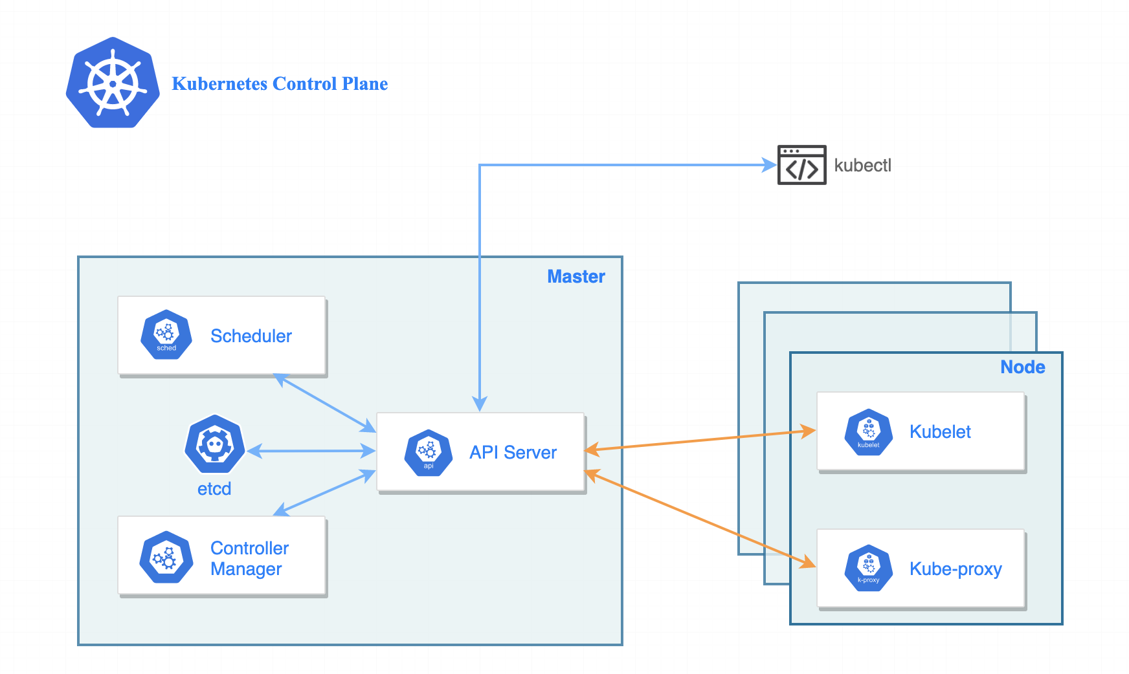
Control Plane High Availability
Ensuring high availability of the Kubernetes control plane is essential to maintain the stability and reliability of your cluster. The control plane components, such as the API server, controller manager, scheduler, and etcd, must be highly available to prevent single points of failure.

Slide 90
Continue …
Replicate Control Plane Components:
Run multiple instances of each control plane component. For example, deploy multiple API server replicas, controller manager replicas, and scheduler replicas.
Distribute these replicas across multiple physical or virtual machines to ensure fault tolerance.
Load Balancing:
Implement a load balancer in front of the control plane components to distribute incoming requests across the replicas.
Use a load balancer with health checks to detect and route traffic only to healthy instances.
Distributed Etcd Cluster:
Set up a distributed etcd cluster to provide fault tolerance for storing and retrieving cluster state information.
Run multiple etcd instances across different nodes, preferably with an odd number of members (e.g., 3, 5, etc.) to ensure quorum-based decision-making.

Slide 91
Continue….
Leader Election:
Configure leader election mechanisms for control plane components that support it. This ensures that only one instance acts as the leader at a given time, while others serve as followers.
Use leader election libraries like client-go or leader election algorithms like Raft to manage leader election.
Monitoring and Alerting:
Implement monitoring for control plane components to detect any failures or performance issues.
Set up alerting mechanisms to notify administrators or an automated system when control plane components are unavailable or experiencing problems.
Regular Backups:
Take regular backups of the etcd data to ensure data integrity and the ability to recover from catastrophic failures.
Test the restoration process periodically to validate the backup reliability.

Slide 92
Continue …
Disaster Recovery Plan:
Have a well-defined disaster recovery plan in place to handle major failures or complete loss of the control plane.
Document the necessary steps and procedures to recover the control plane and restore the cluster to a functional state.
Regular Maintenance and Upgrades:
Perform regular maintenance tasks, such as patching, upgrading, and security updates, on the control plane components to ensure they are running the latest stable versions.
Conduct rolling upgrades, ensuring that at least the minimum required number of replicas for each control plane component is always available during the upgrade process.

Slide 93
Autoscaling
Auto scaling in Kubernetes allows you to automatically adjust the number of pods running in a deployment, replicaset, or horizontal pod autoscaler (HPA) based on resource utilization or custom metrics. It helps you efficiently allocate resources to meet the demand of your applications and ensures optimal performance without manual intervention.
Here's an overview of auto scaling in Kubernetes:
Horizontal Pod Autoscaler (HPA):
HPA automatically scales the number of pods in a deployment or replicaset based on CPU utilization or custom metrics.
Configure the target CPU utilization or custom metric thresholds to trigger scaling actions.
HPA periodically checks the resource utilization and adjusts the number of replicas to maintain the desired utilization.

Slide 94
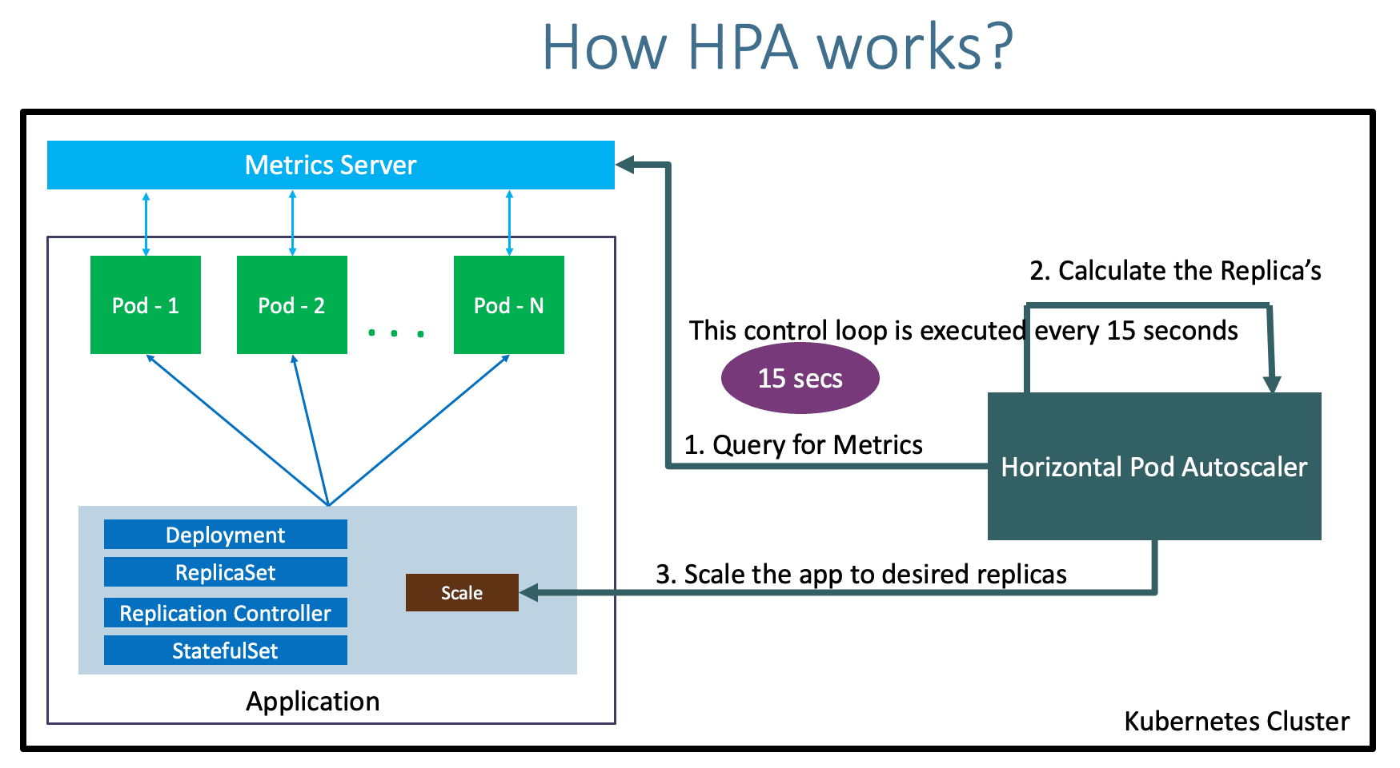
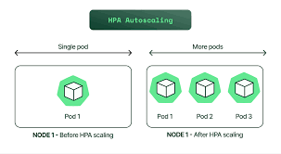
HPA

Slide 95
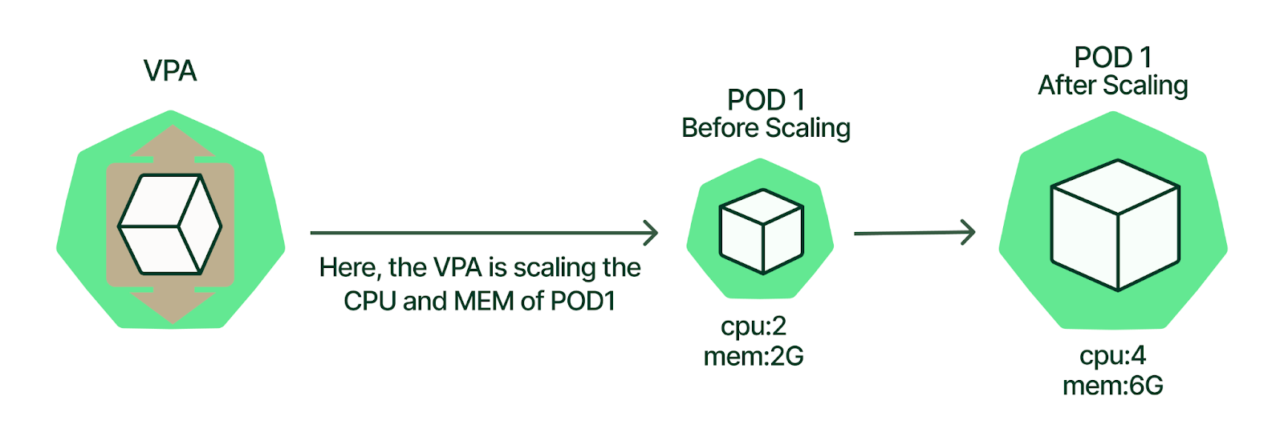
Autoscaling
Vertical Pod Autoscaler (VPA):
VPA adjusts the resource requests and limits of individual pods based on historical utilization.
VPA analyzes the resource usage patterns and recommends or applies changes to the pod specifications to optimize resource allocation.

Slide 96
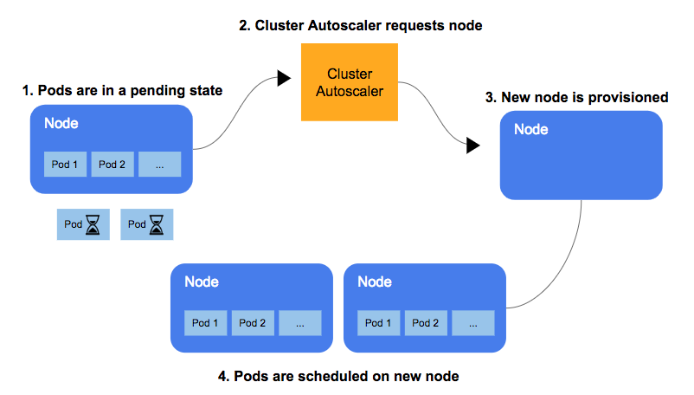
Cluster autoscaling
Cluster Autoscaler:
Cluster Autoscaler automatically adjusts the size of the Kubernetes cluster by adding or removing nodes based on the pending pods and resource demands.
When pods cannot be scheduled due to resource constraints, Cluster Autoscaler provisions new nodes. Conversely, when nodes are underutilized, it scales down the cluster by removing nodes.

Slide 97
Continue..
Custom Metrics and External Metrics:
Kubernetes allows you to define custom metrics or use external metrics from third-party monitoring systems to drive auto scaling decisions.
Custom Metrics APIs and custom metrics adapters enable the consumption of these metrics by the HPA for scaling actions.
Auto Scaling Configuration:
To enable auto scaling, you need to define the desired auto scaling behavior for your deployments, replicaset, or statefulset by specifying the target CPU utilization, custom metrics, or other relevant parameters.
Use the Kubernetes API or YAML configuration files to define the desired auto scaling behavior.

Slide 98
Continue..
Monitoring and Alerting:
Implement monitoring and alerting to track the performance, resource utilization, and scaling events of your applications and the cluster.
Configure alerts to notify administrators of any scaling activities or when thresholds are breached.
Auto scaling allows your Kubernetes cluster to dynamically adjust resources to meet application demands, optimize resource utilization, and handle traffic spikes. By automating the scaling process, you can ensure that your applications are responsive, cost-effective, and provide a great user experience.

Slide 99
Continue..
apiVersion: autoscaling/v2beta2
kind: HorizontalPodAutoscaler
metadata:
name: my-hpa
spec:
scaleTargetRef:
apiVersion: apps/v1
kind: Deployment
name: my-deployment
minReplicas: 1
maxReplicas: 10
metrics:
- type: Resource
resource:
name: cpu
targetAverageUtilization: 70
apiVersion: autoscaling.k8s.io/v1
kind: VerticalPodAutoscaler
metadata:
name: my-vpa
spec:
targetRef:
apiVersion: "apps/v1"
kind: Deployment
name: my-deployment
updatePolicy:
updateMode: "Auto"

Slide 100
Troubleshooting
Troubleshooting in Kubernetes can involve identifying and resolving issues related to application deployments, networking, cluster components, and more. Here are some general troubleshooting steps and techniques that can help you diagnose and resolve problems in your Kubernetes environment:
Check Cluster Status:
Run kubectl cluster-info to get an overview of the cluster's health and connectivity.
Use kubectl get nodes to verify the status of individual nodes in the cluster.
Inspect Pod Status:
Run kubectl get pods -n <namespace> to check the status of pods in a specific namespace.
Use kubectl describe pod <pod-name> -n <namespace> to get detailed information about a specific pod, including events and errors.

Slide 101
Continue…
Review Logs:
Retrieve container logs using kubectl logs <pod-name> -n <namespace> to analyze application-specific logs.
Use kubectl logs -f <pod-name> -n <namespace> to stream the logs in real-time for troubleshooting.
Debug Networking:
Use kubectl describe pod <pod-name> -n <namespace> to check if the pod's networking settings and IP allocation are correct.
Inspect Kubernetes Services and Endpoints to ensure correct routing and connectivity.
Verify Network Policies to ensure the pod's ingress and egress rules allow the required network traffic.

Slide 102
Continue…
Monitor Resource Utilization:
Monitor CPU, memory, and disk utilization of nodes and pods using tools like Prometheus, Grafana, or Kubernetes Dashboard.
Identify resource bottlenecks or abnormal spikes that may impact application performance.
Upgrade and Patch:
Ensure you are running the latest stable versions of Kubernetes components and update if necessary to benefit from bug fixes and security patches.
Community Resources:
Leverage the Kubernetes community resources, including official documentation, GitHub issues, forums, and Slack channels, to search for known issues and get help from experts

Slide 103
To Note …..
Remember that troubleshooting in Kubernetes can be complex, and the steps may vary based on your specific environment and deployment configurations. It's important to gather relevant information, analyze logs, and use available monitoring and debugging tools to pinpoint the root cause of the problem.

Slide 104
Exercise
You are tasked with deploying a simple web application on Kubernetes that requires a database backend. Follow the steps below to complete the exercise:
Create a Deployment for the Database:
Create a Deployment named "database-deployment" for a MySQL database.
Use the MySQL image with the tag mysql:5.7.
Configure the deployment to have 1 replica.
Set the environment variables MYSQL_ROOT_PASSWORD and MYSQL_DATABASE to appropriate values.
Create a Service for the Database:
Create a Service named "database-service" to expose the MySQL database within the cluster.
Ensure the Service is of type "ClusterIP" and targets the MySQL deployment.
Create a Deployment for the Web Application:
Create a Deployment named "webapp-deployment" for a simple web application.
Use the NGINX image with the tag nginx:1.21.1.
Configure the deployment to have 2 replicas.
Set the environment variable DATABASE_HOST to the DNS name of the "database-service".
Expose the Web Application:
Create a Service named "webapp-service" to expose the web application externally.
Ensure the Service is of type "LoadBalancer" and targets port 80 of the NGINX deployment.
Provide the YAML files:
Provide the YAML files for the Database Deployment, Database Service, Web Application Deployment, and Web Application Service. Ensure each resource is in a separate YAML file.
Ensure that your solution includes the necessary specifications, labels, and other required fields for each resource.

Slide 105

Q&A

Slide 106
Thank you

